Slide 1
Moon Village Association - Italy
Space Summer School
Beyond Borders Edition
IMD2024P
Ferruccio Diozzi
Associazione Amici di Città della Scienza
A look at science and Sci-Fi between dreams and nightmares

Slide 2
Introduction
The relationship between humans and space has always provided inspiration and ideas for artistic representation.
In particular, from the 19th century onwards, first Literature, then arts such as Cinema and Comics have been fertile grounds for scientific and science fiction imagination between dreams and nightmares.
Below we present some examples highlighting both recurring topics and certain forms of narration.

Slide 3

Greek Roman Antiquity
We begin with Lucian of Samosata to investigate “The Journey” as an essential dimension of every Science Fiction stories.
Lucian, who lived in Greece during the time of the Antonine emperors, (about 120-180/192 AD), was a writer, rhetorician, and philosopher of ancient Greek-speaking Syria. He is famous for his wit and the strong irreverence of his corrosive satirical writings, in which he often ridiculed superstition, religious practices, and belief in the paranormal.
In his A True Story he realizes a travel story, involving impossible journeys to nowhere lands populated by strange creatures. The author mocks all ancient beliefs with the tools of paradox and exaggeration.

Slide 4

3 forerunners of the Nineteenth century
In 1835 «The New York Sun» fantasized about extraordinary discoveries revealed thanks to the telescope built at the Cape of Good Hope by the British scientist Sir John Herschel, the most illustrious astronomer of the time.
One year later, in Naples, an anonymous pamphlet was printed that proposed again the topic. (On the Discoveries Made in the Moon by Dr. Giovanni Herschel).
In the same time, the Neapaolitan Fergola Brothers Typography published some successfull lithographs starring…… Pulcinella on journey to the Moon.

Slide 5
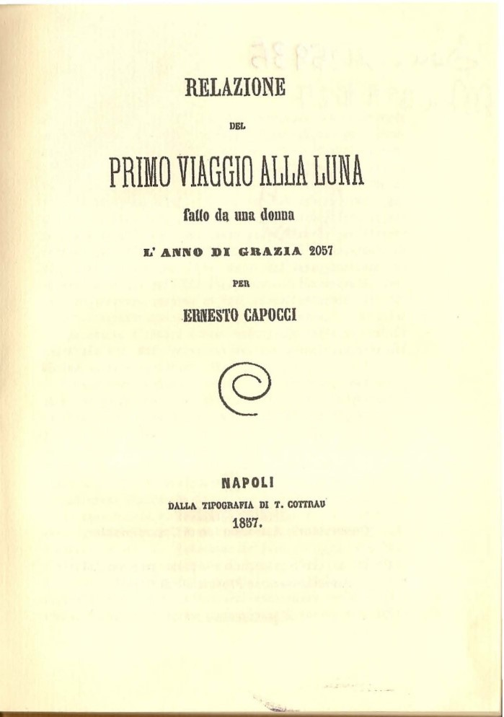
3 forerunners of the Nineteenth century
In 1857 Ernesto Capocci, italian mathemathician, astronomy and politician, writes Report of the First Voyage to the Moon, a chronicle of a fantastic journey to the satellite, published eight years before Verne's From the Earth to the Moon.
Set in a futuristic 2057, is the first journey of its kind made by a woman.

Slide 6

3 forerunners of the Nineteenth century
In 1871 Louis Auguste Blanqui, french astronomy and revolutionary, as for most of his life is in prison.
There he composed a visionary treatise Eternity by the stars (L'Eternité par les astres) of "metaphysical astronomy," which advances a dizzying hypothesis:
«Every star, any star exists an infinite number of times in time and space, not in just one of its forms, but as it is in each of the moments of its existence, from birth to death. And all the beings scattered across its surface, large and small, living or inanimate, share the privilege of this perenniality. The earth is one of the celestial bodies. Every human being is therefore eternal, in each of the moments of his existence.»

Slide 7
TOPICS
Now take a look at some typical themes of modern science fiction with a particular connection to Space and Space Exploration.
Imagination: as ability to imagine new worlds and new ways of human behavior.
Optimism: thinking in positive terms, especially after dramatic and destructive events such as war.
Warning from Space: knowledge of new worlds can also include dramatic warning messages.
Threat from Space: Space and New worlds can also bring threats.

Slide 8

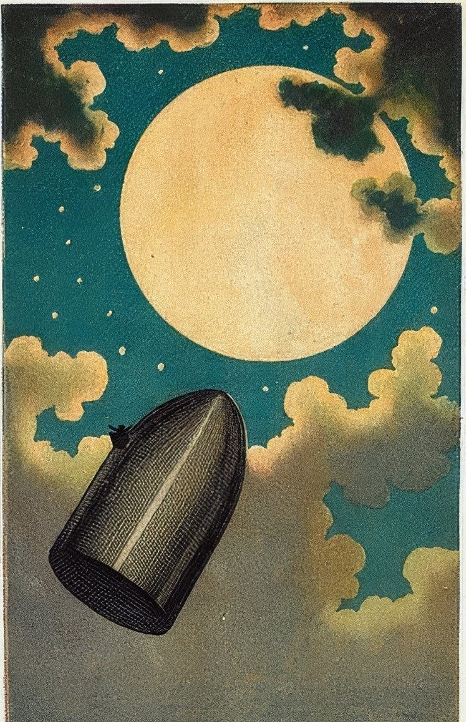
Imagination: From the Earth to the Moon - De la Terre à la Lune, trajet direct en 97 heures 20 minutes
1865: The first masterpiece of modern science fiction in which Jules Verne imagines the journey to the moon by a group of scientists and technologists.
Notes:
Members of the Gun Club, an American artillerymen's association, announce that they have invented a cannon capable of firing a projectile capable of reaching the Moon. The project envisages that the projectile is spherical in shape, built in aluminium, and that the launching device, an enormous gun embedded in the ground, uses the lightning cotton as a detonator. However the test launch is successful. In the presence of spectators from all over the world, the projectile is then launched into space. But the men above will not reach their destination: the capsule will enter the Moon's orbit and rotate around it like a satellite. Only ingenuity and teamwork will be able to save them from long agony and death from asphyxiation or starvation.

Slide 9
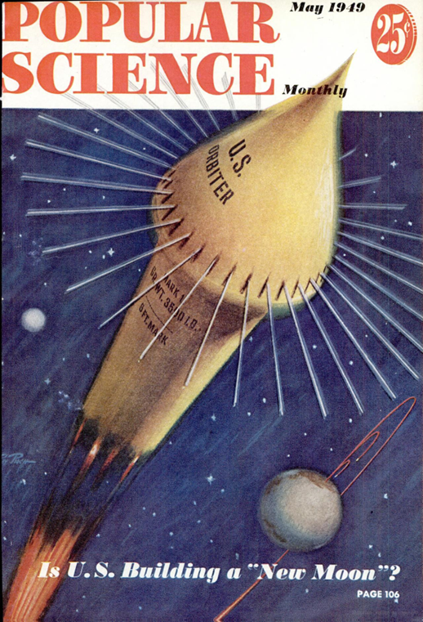
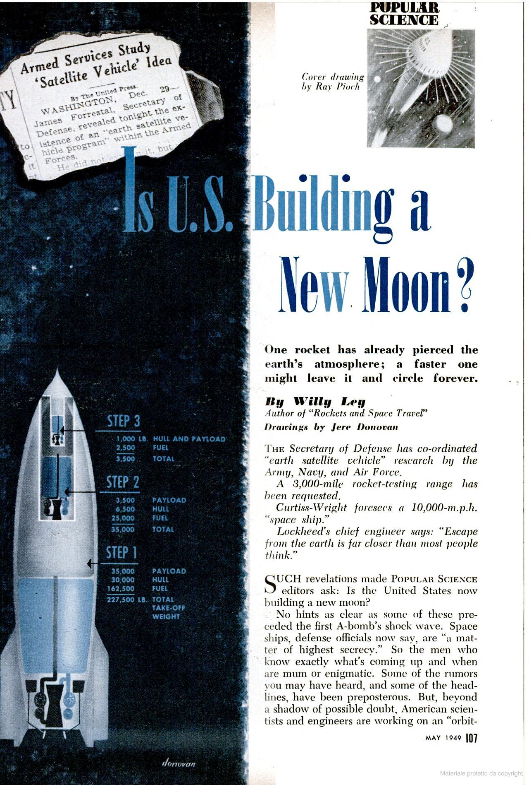

Optimism: after the Second World War
In 1949, «Popular Science», the oldest scientific dissemination magazine, talks about a possible "new moon“.
It actually refers to the new speed capabilities of vehicles such as rockets.
How we can read in the article:
“One rocket has already pierced the earth's atmosphere.
A faster one might leave it and circle forever.”

Slide 10
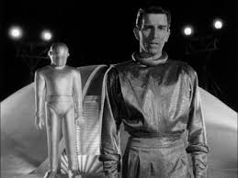
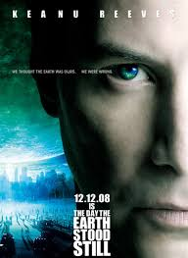
Warning from Space: The day that Earth stood still
In 1951 movie the alien Klaatu explains to the representatives of different country on Earth that an interplanetary organization has created. "In matters of aggression, we have given them absolute power over us". Let’s listen to Klaatu’s message…….
https://www.youtube.com/watch?v=mXPzHhA8fX8
Even more dramatically, in 2008 movie Klaatu is a representative from a group of planetary civilizations with a mission:
To save the Earth from destruction by humankind………..
https://www.youtube.com/watch?v=tkeDTL7bIKM
Notes:
Klaatu concludes, "Your choice is simple: join us and live in peace, or pursue your present course and face obliteration. We shall be waiting for your answer.“
“If you die the Earth survive…”

Slide 11
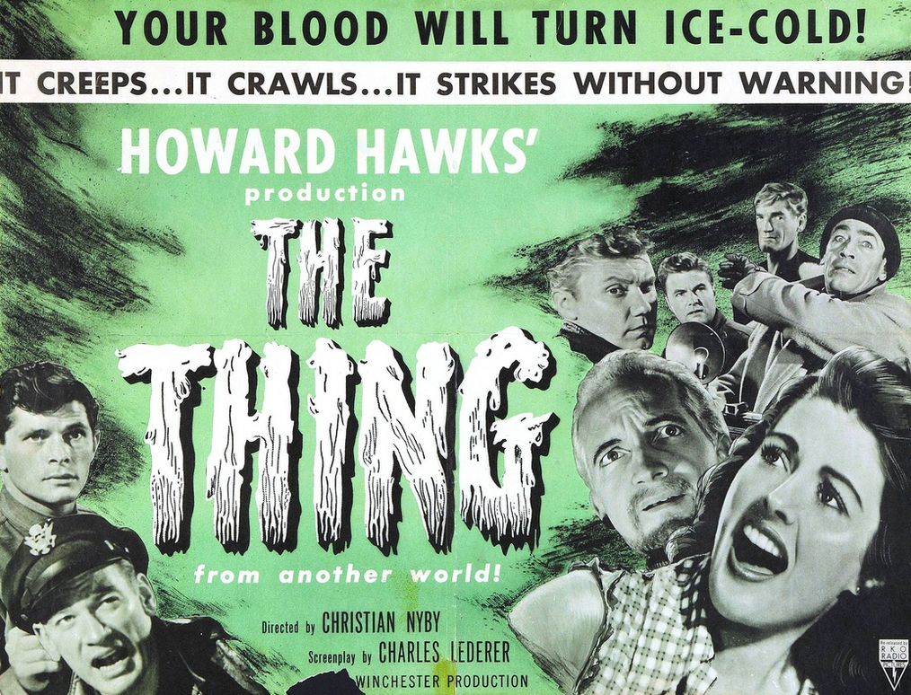

Threat from Space: The Thing
1951: At the end of the movie, after the defeat of the alien creature, Captain Patrick Hendry issues his warning in a radio broadcast…… https://www.youtube.com/watch?v=rmDqKUEKW_Y
1982: in John Carpenter's version there is no hope: Mac Ready and Childs are the only survivors, they could die from the cold and they suspect each other of being the thing...
https://www.youtube.com/watch?v=mZ-G2q6me2s
https://www.youtube.com/watch?v=6XEhIOqLoZE
Notes:
“Tell the world. Tell this to everybody, wherever they are. Watch the skies everywhere. Keep looking. Keep watching the skies...".

Slide 12
SAGAS
Now let’s take a look on some forms of SCI FI storytelling.
SCI FI stories have often needed to build themselves as epic stories, as sagas.
Below are two classic examples where telling about space and other worlds often meant crossing different dimensions until reaching what I call the “fusion of times."

Slide 13
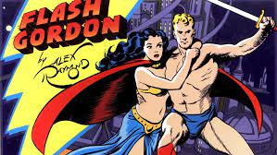
Archetype of science fiction comics (but not the first one…), created by Alexander Gillespie Raymond, the comic strip follows the adventures of Flash Gordon and his companions Dale Arden and Dr. Hans Zarkov.
The story begins with Earth threatened by a collision with the planet Mongo. Dr. Zarkov invents a rocket ship to fly into space in an attempt to stop the disaster. Half mad, he kidnaps Flash and Dale.
Landing on the planet, and halting the collision, they come into conflict with Ming the Merciless, Mongo's evil ruler.
Sagas: Flash Gordon, 1934

Slide 14
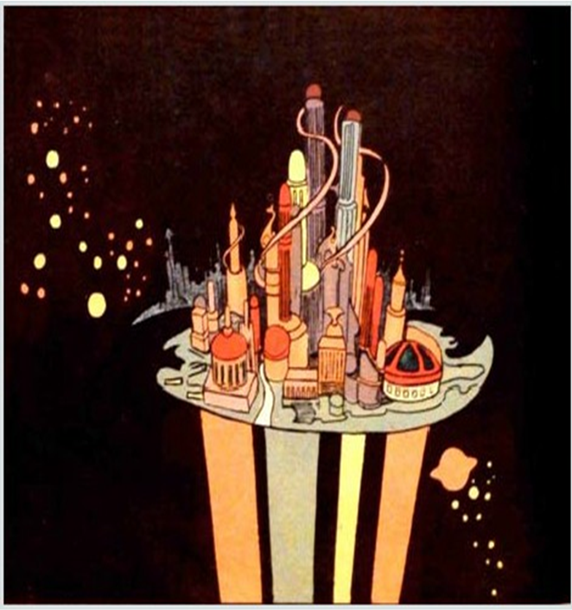
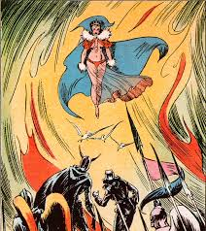
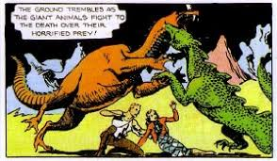
Sagas: Flash Gordon, 1934
The planet Mongo, where Gordon crashes, is a strange blend of the Orient, Greek-Roman antiquity, and the political climate of the 1930s.
In Mongo ancient ways of life coexist with elements of fantasy literature such as dragons, witches and wizards. But devices, machines and forms of energy inconceivable for the terrestrial civilization of the time are also active.
Notes:
Some examples: the suspended city of the hawk men, Queen Azura the witch,
Fight between monsters

Slide 15
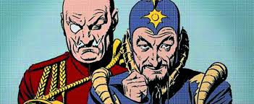
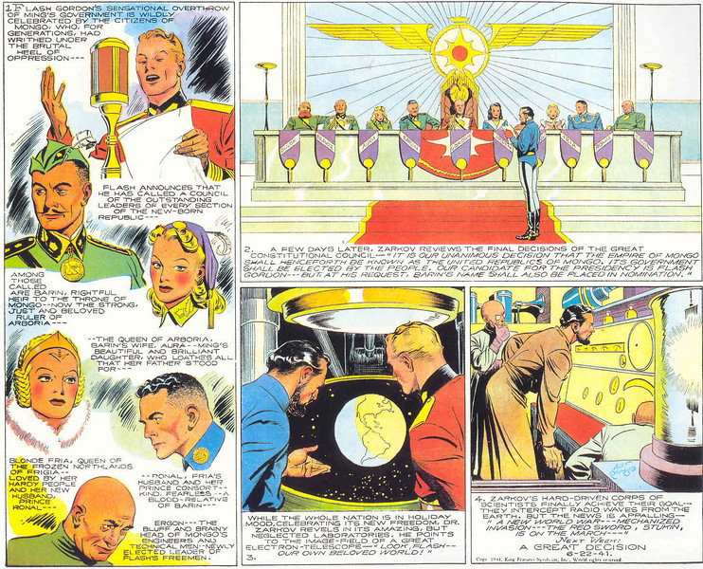
A handful of free men are fighting to overthrow the empire of Ming, probably one of the best villains ever conceived in a comic.
It must be said that the Ming empire will gradually accentuate the similarity with the Nazi regime over the course of the comic's life.
In 1940 the struggle will end with the full success of free men with the advent of a league of democratic Kingdoms and Republics.
An anticipation of the United Nations established in 1942.
Sagas: Flash Gordon, 1934

Slide 16
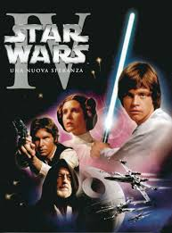
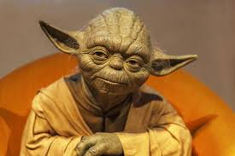
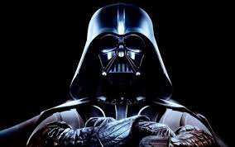
Sagas: Star Wars, 1977-
A quick look at what has become one of the greatest movie successes of all time, Star Wars.
In 1971, George Lucas, a young director of New Hollywood, wanted to make a movie based on the adventures of Flash Gordon. He couldn't obtain the rights and began developing the idea for an his own saga.
In 1977 Star Wars was born, set in an imaginary galaxy and based on the eternal struggle between good and evil.
https://www.youtube.com/watch?v=_D0ZQPqeJkk

Slide 17
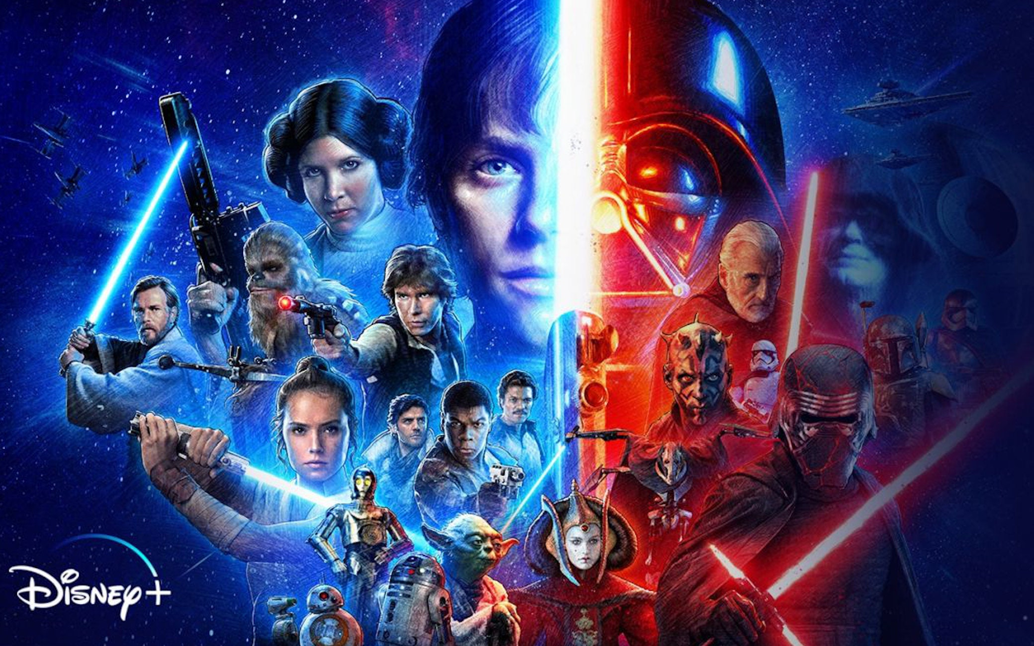
Sagas: Star Wars, 1977-
Now Star Wars is a media franchise, since 2012 owned by Disney, which develops from a film series
Star Wars (1977)
The Empire Strikes Back (1980)
Return of the Jedi (1983)
The Phantom Menace (1999)
Attack of the Clones (2002)
Revenge of the Sith (2005)
Force Awakens (2015)
The Last Jedi (2017)
The Rise of Skywalker (2019)
It was alternated with an Anthology series including Rogue One: A Star Wars Story (2016) and Solo: A Star Wars Story (2018).
Notes:
The series draws inspiration from several works, including the Flash Gordon serials, Akira Kurosawa's films, Frank Herbert's Dune Cycle and Joseph Campbell's studies of mythology.

Slide 18
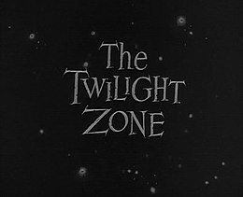
SERIALITY
Seriality is one of the most widespread and typical characteristics of television drama.
It is a mechanism that had already been used by popular art forms prior to television.
We have many examples of sci-fi serials from the classic The Twilight Zone (1959-1964)
https://www.youtube.com/watch?v=ORbseYAkzRM

Slide 19
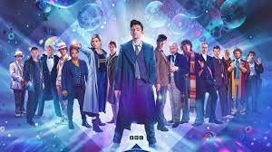
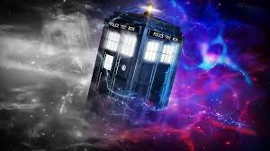
Dr. Who, 1963-
https://archive.org/details/tvtunes_185
Dr. Who is a Time Lord, a time-traveling alien with human features who simply calls himself The Doctor. The Doctor explores the universe aboard the TARDIS, a sentient machine capable of traveling through space and time through the so-called time vortex.
Over the years the Doctor can "regenerate": a faculty of the Time Lords thanks to which he can continue to live in a new body, different from the previous one, but which also involves a change in personality.

Slide 20
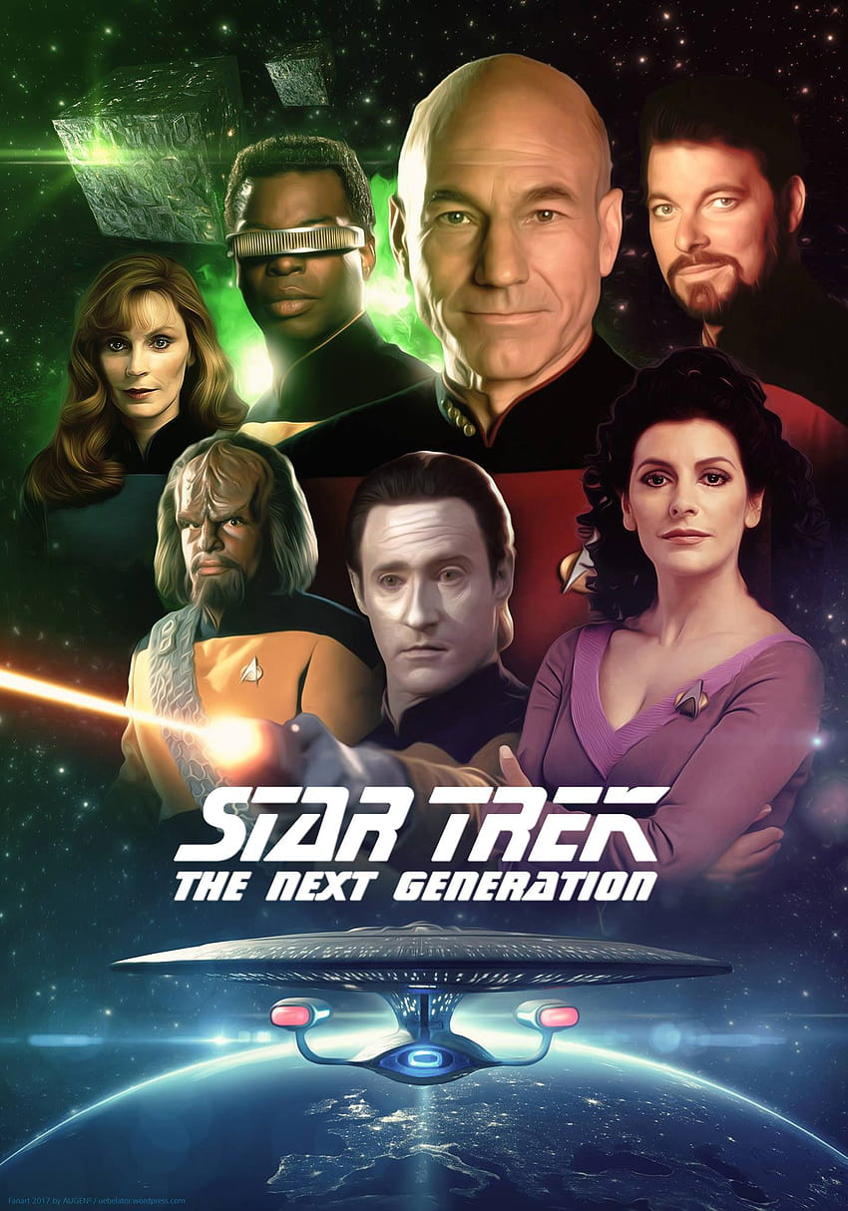
Star Trek, 1966-
https://www.youtube.com/watch?v=EWSp5ijOOfk
Set in a remote future, Star Trek tells the adventures of the crew of the USS Enterprises spaceship heading to the exploration of new worlds, in search of other forms of life and civilization.
The Enterprise belongs to a Federation of United Planets that brings together peoples from different star systems under a single government.
The captain of the Enterprise is James T. Kirk, assisted by the science officer Spock, an alien from the planet Vulcan and by the medical officer, Dr. Leonard McCoy known as "Bones”.

Slide 21
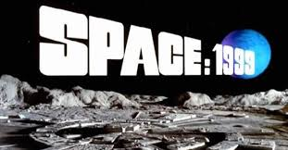
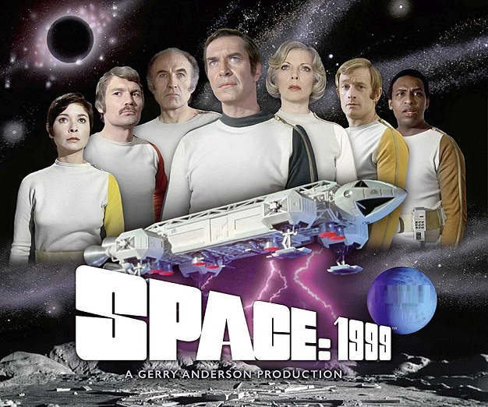
Space:1999, 1975-1977
https://www.youtube.com/watch?v=4SpX8bVEmJo
Space 1999 narrates the odyssey of the members of a lunar colony, adrift in space following the removal of our satellite from Earth's orbit.
Led by Commander Koenig, supported among others by Dr. Russell and Dr. Bergmann, then in the second serie from the alien Maya, the members of the lunar colony will try to return to Earth knowing and facing various situations.

Slide 22
As conclusions
This presentation aims to offer just a few ideas, perhaps touching on memories of things read, seen, or heard over the years.
It does not claim to be comprehensive: the realm of science fiction is by nature open, and it would be illusory to attempt to summarize it in a few slides.
However, we thought it would be interesting to try to draw a logical thread. I hope I succeeded.
Thank you for your attention!

Slide 23
Note
All images and passages of this presentation are used for educational and informative purposes only.
Any commercial use is excluded.

Slide 24

Ferruccio Diozzi
Consultant in Library and Information Science, former Head of Documentation Center at CIRA, Italian Center of Aerospace Research.
Expert of Science Fiction literature, cinema and comics with particular attention to space exploration.
Founding Member and past President of Amici di Città della Scienza, a non-profit association made up of professionals from heterogeneous backgrounds who share the aims of the IDIS Città della Scienza Foundation and want to broaden its range of action.
Ferruccio.diozzi@gmail.com
https://www.facebook.com/ferruccio.diozzi?locale=it_IT
https://www.linkedin.com/in/ferrucciodiozzi/

